Slide 1
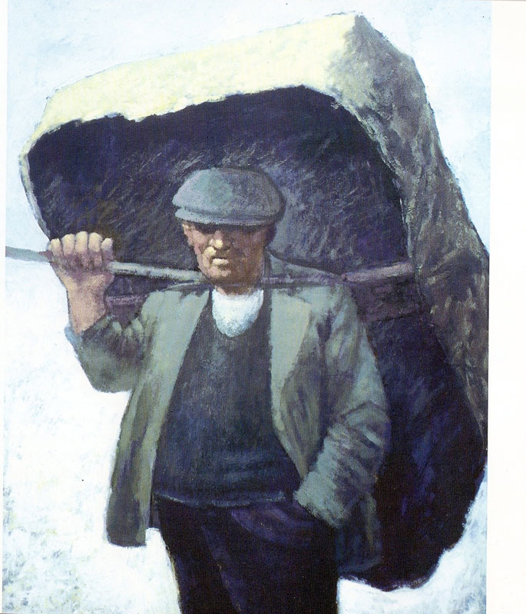
Used with kind permission of Aneurin Jones
A series of interactive lessons and instructions for teachers to create a art project:
Years 5 a 6
Lesson 7
Workers and the workhouse during Victorian Times
Next page
Notes:
1

Slide 2
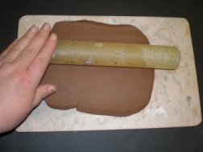
Creating a model of a Victorian workhouse by using a clay mould and plater of Paris.
Task: Press an image of a Victorian workhouse into clay and then create a plaster mould.
Care needed when using plaster of Paris. Adult supervision necessary.
Click on the picture for a step by step guide for this task.
The Technique: Use different equipment and your fingers to press an image into the slab of clay. Mix and pour plaster of Paris into the mould. Wait for the plaster o Paris to solidify in order to create a hard mould.
Your teacher is looking for evidence of life and emotion of the period as you use techniques correctly.
Previous Page
Next Page

Slide 3
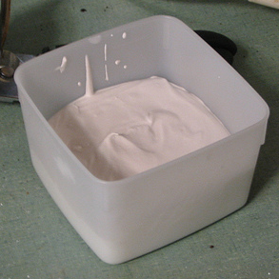
Health and Safety Warning:
Please read carefully the health and safety instructions for the correct use of plaster of Paris.
Previous page
Next page

Slide 4
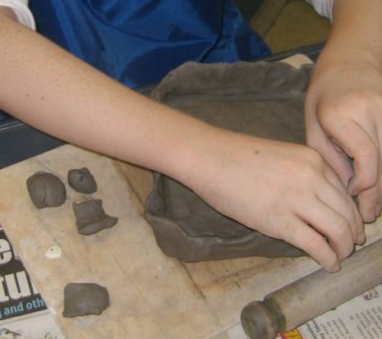
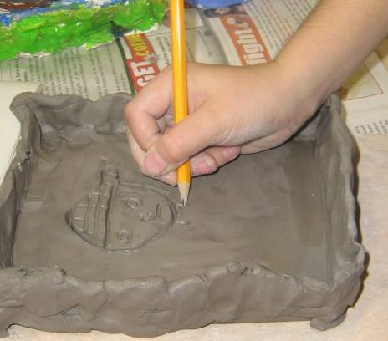
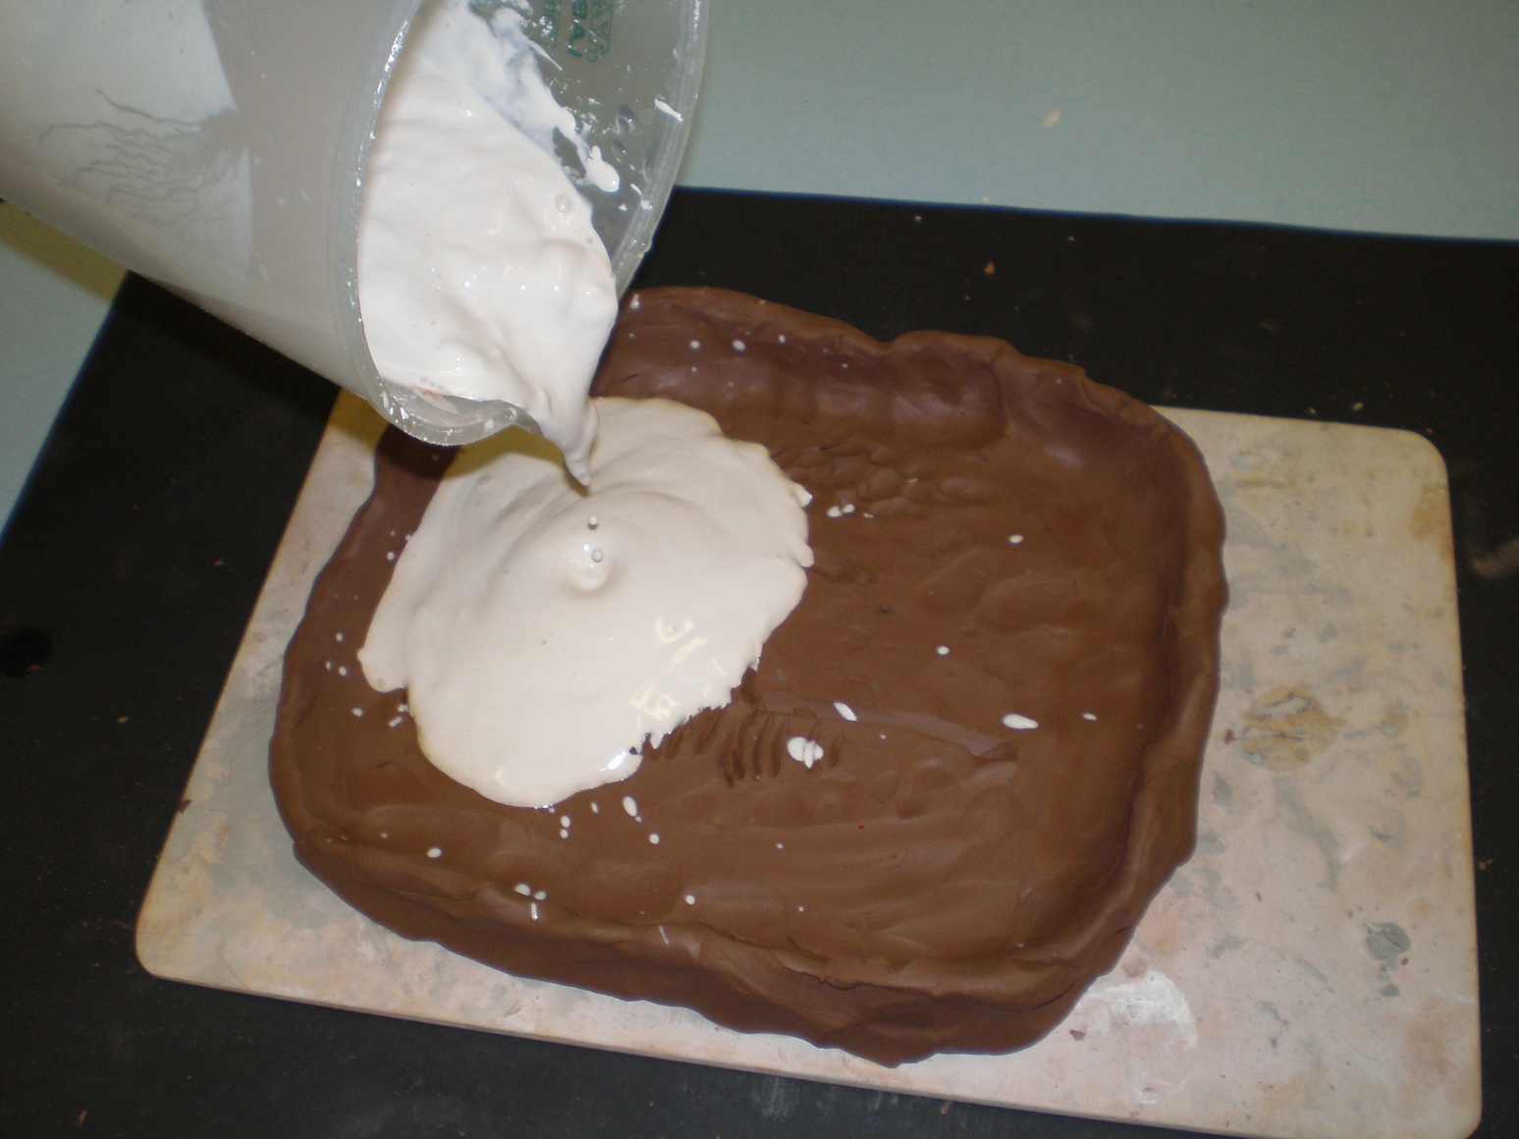
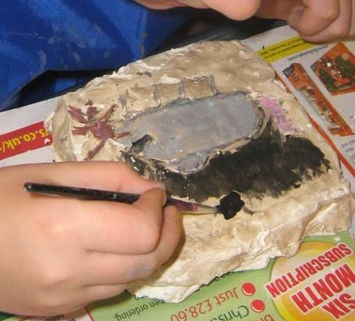
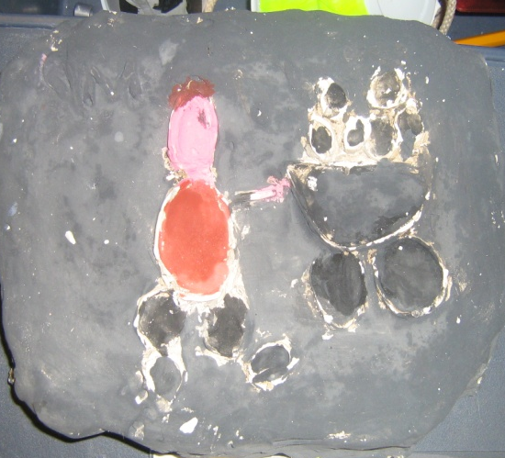
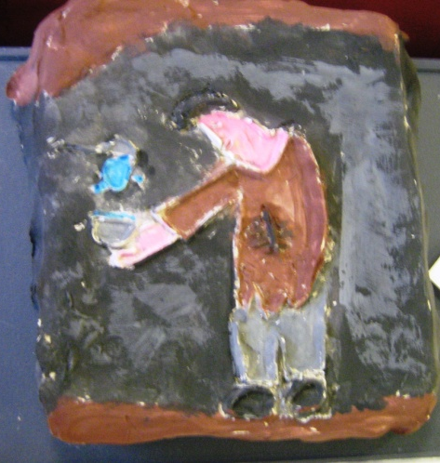
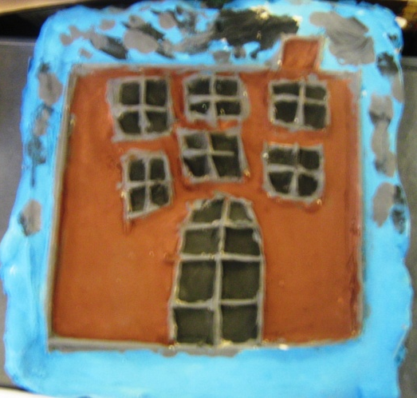
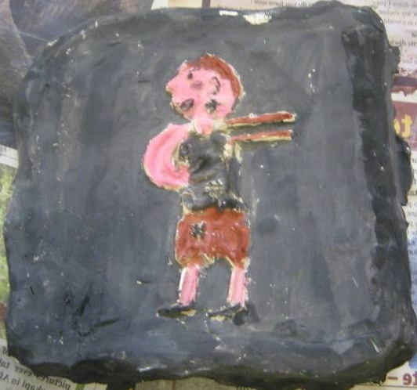
The process in pictures
Completed examples
Previous page
Next page

Slide 5

1. Create a flat slab of plaster.
Previous page
Next page

Slide 6
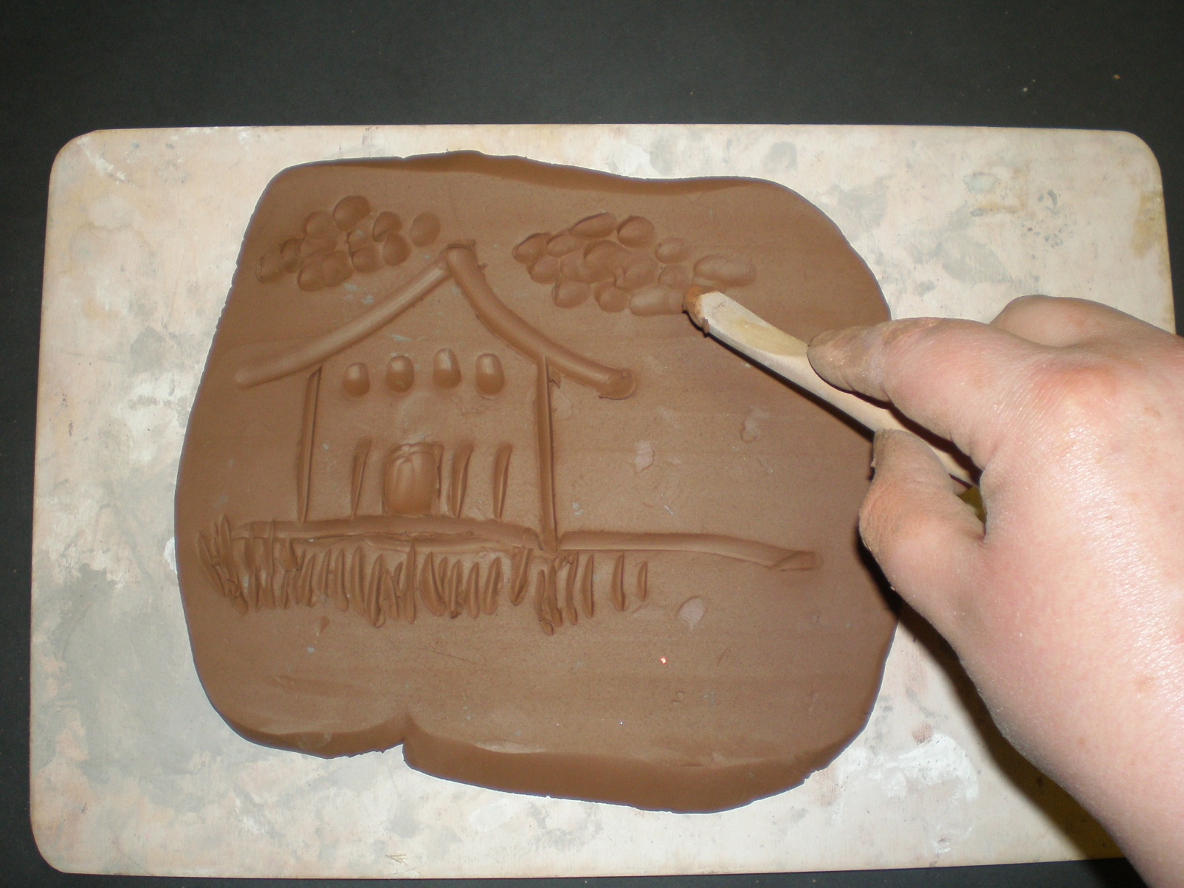
2. Press an image of a Victorian workhouse into the slab of clay.
Previous Page
Next page

Slide 7
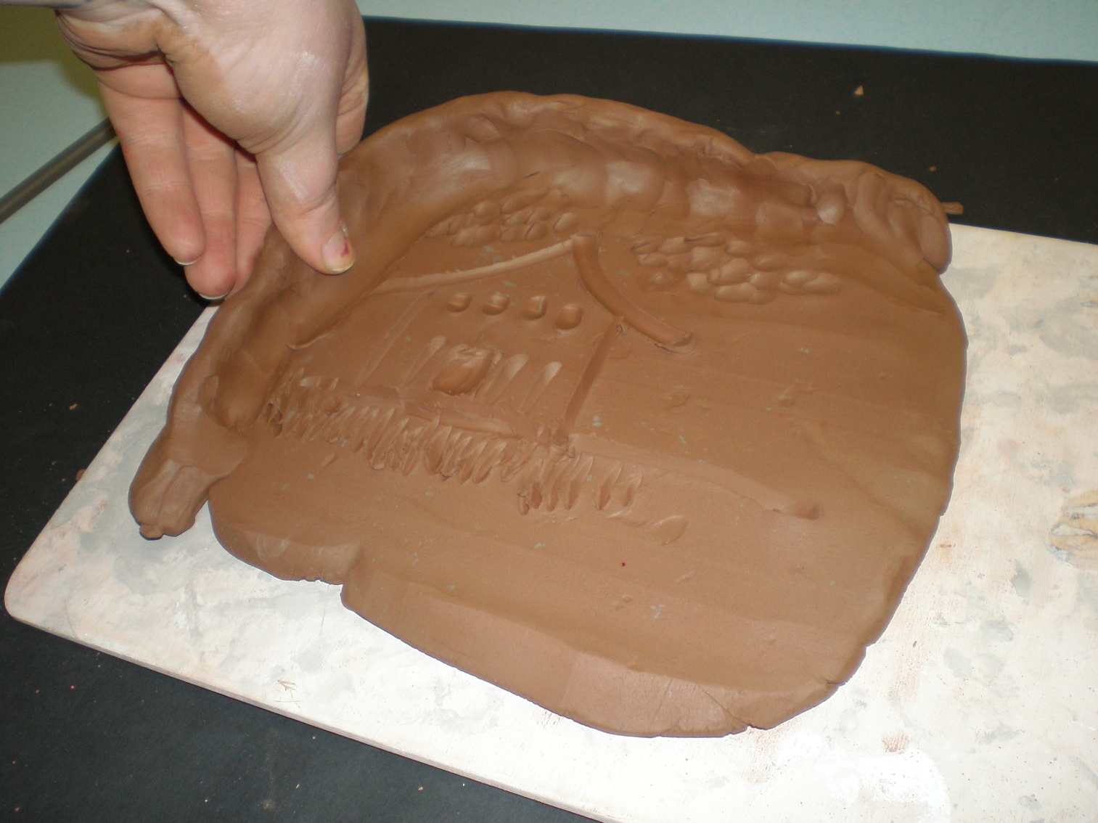
3. Build up a wall of clay with no gaps around the edge of the slab of clay.
Previous page
Next page

Slide 8
4. Pour a mixture of plaster onto the clay.
Previous page
Next page

Slide 9
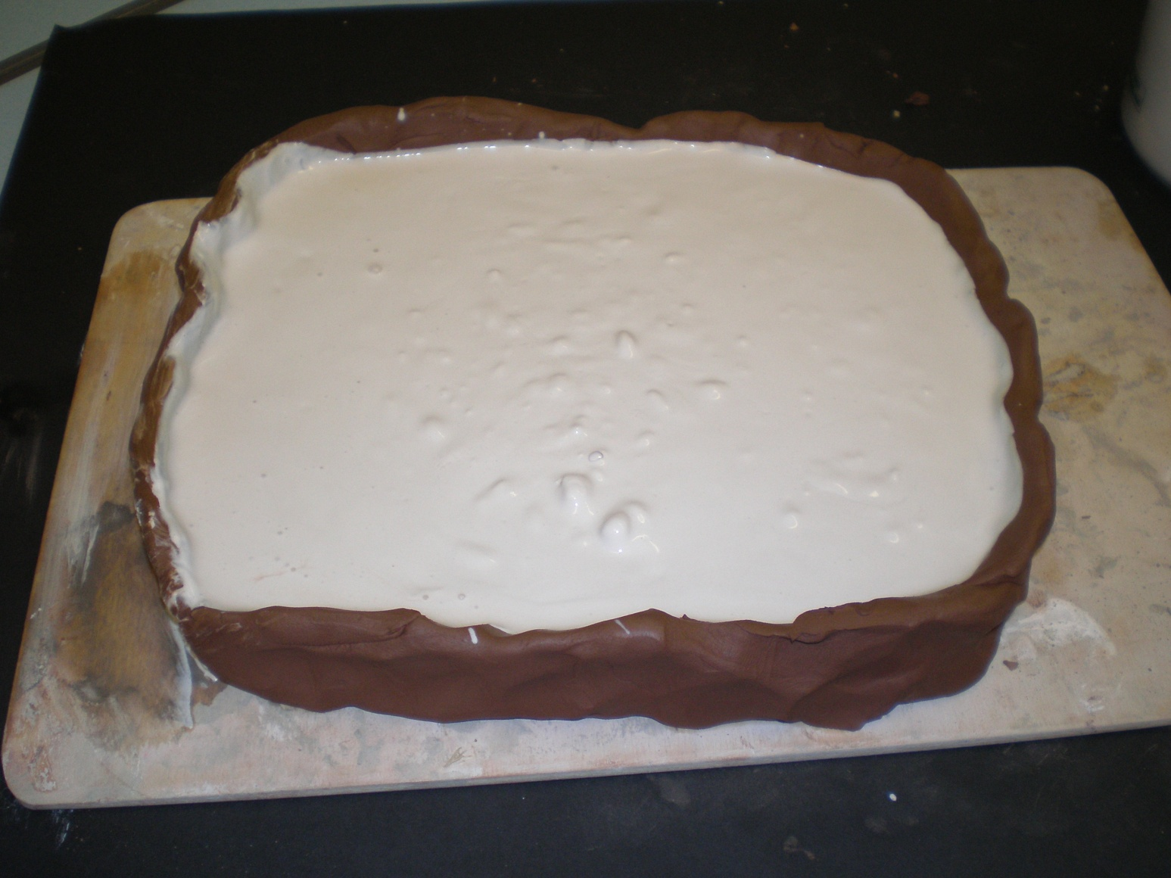
5. Leave the plaster to solidify. Remember to add pieces of hessian into the mixture to allow the piece to strengthen.
Previous page

